Slide 1


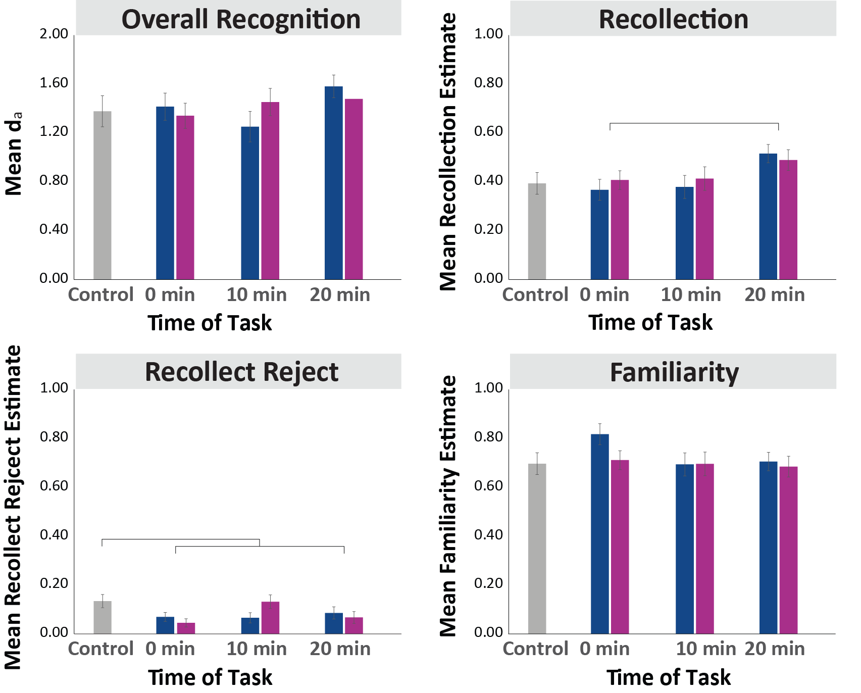
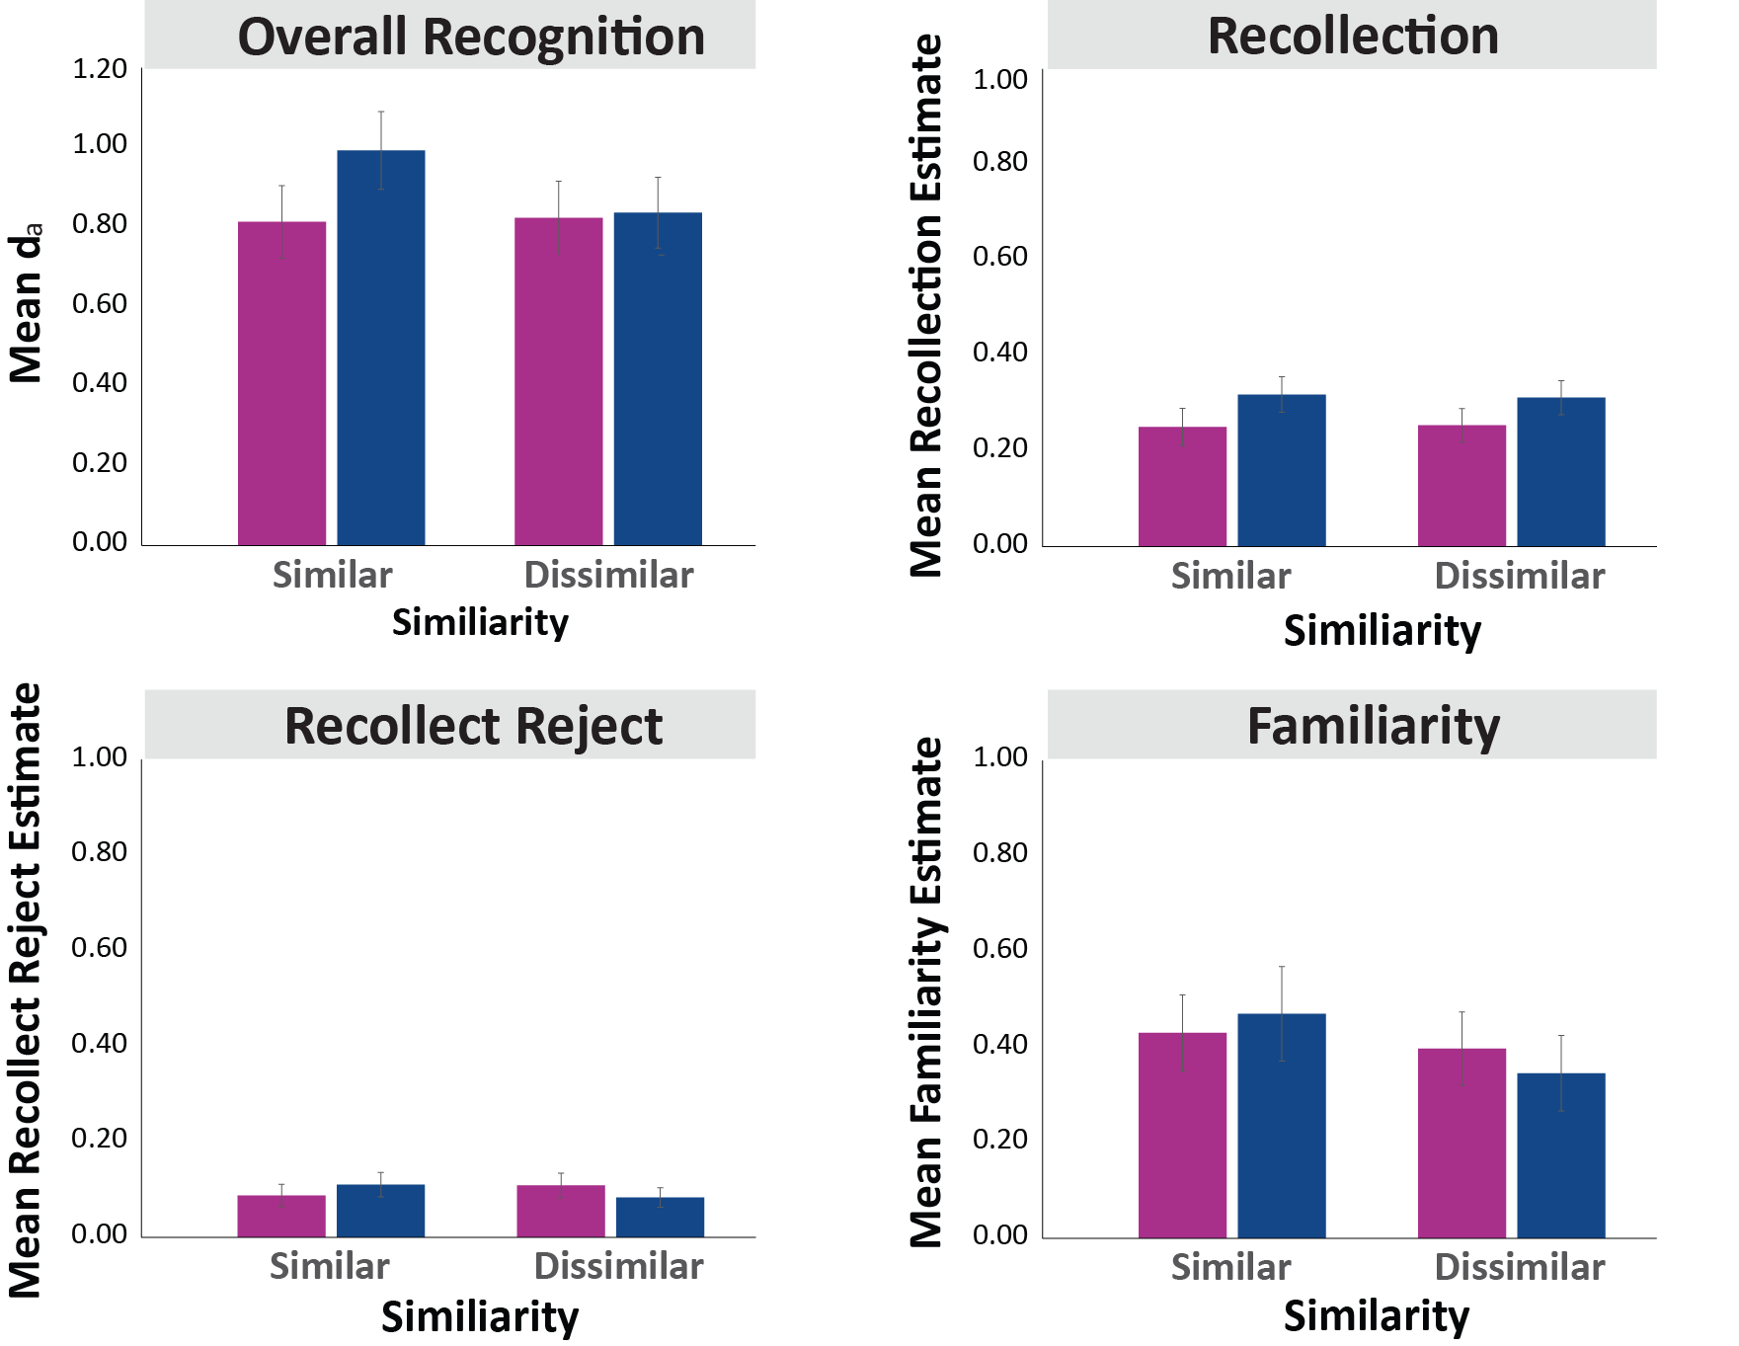
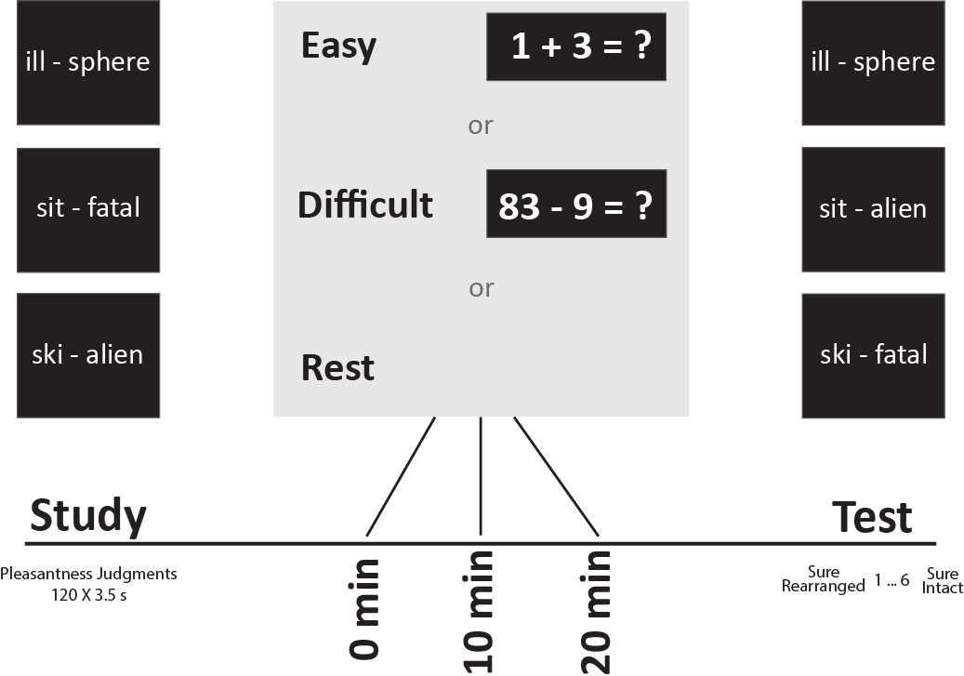
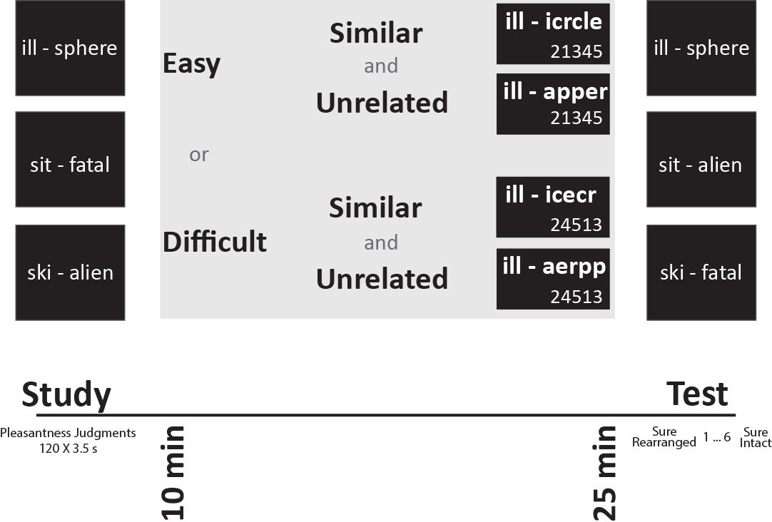
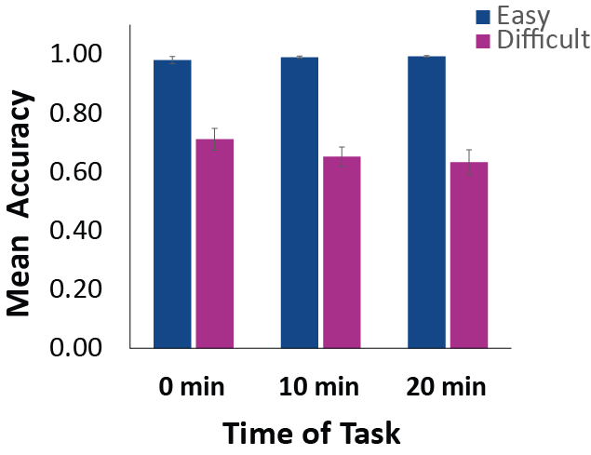
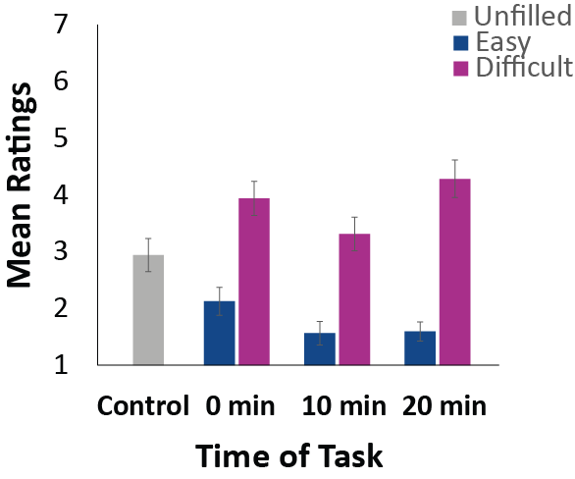
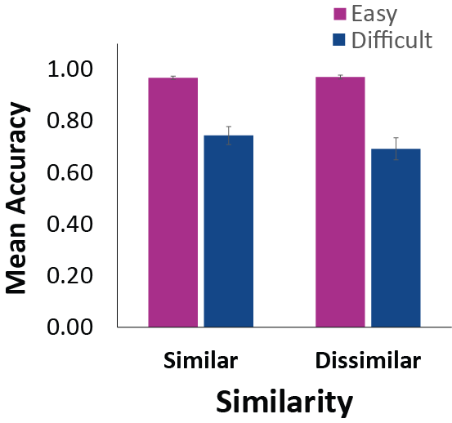
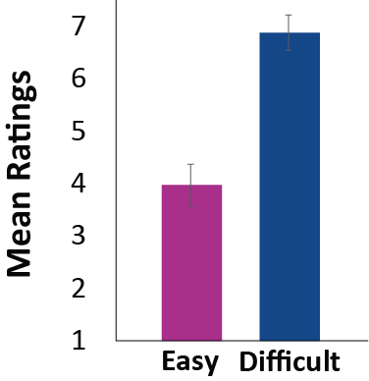
Retroactive Interference in Recognition Memory: Effects of Mental Effort and Similarity on Recollection and Familiarity
Caleb J. Picker & Colleen M. Parks
University of Nevada, Las Vegas
Human Memory Lab
Introduction
Experiment 1 Results
Experiment 2 Results
Retroactive interference (RI) occurs when new material interferes with memory of previously learned material. Early theories of forgetting posited that mental effort was a cause of RI (and thus forgetting), but later work focused on response competition.
Wixted (2004) proposed that both mental effort and response competition can cause forgetting, and that mental effort is the more common cause (see also Dewar et al., 2007).
We expected that the degree of mental effort and the timing of the effortful task would affect recollection, and that the effort effect would depend on the timing of the interference.
We expected that increasing the similarity between studied and interfering material would increase the RI effect, which might depend on the effort expended on the interfering material.
Experiment 1 Method
Experiment 2 Method
Discussion
The timing of the interfering task affected recollection in Experiment 1; delaying the task for 20 minutes increased recollection. This pattern is consistent with the consolidation hypothesis (e.g., Wixted, 2004), mental effort had no effect (see also, Dewar et al., 2009). Familiarity was not affected by either manipulation.
Neither mental effort nor similarity affected performance in Experiment 2.
The null effect of mental effort was surprising. Of several potential explanations is the possibility that mental effort is a misnomer; the effects of routinely effortful activities on prior learning may be due to competition between old and new memories for hippocampal resources (Wixted, 2004), and some mentally effortful tasks may not recruit hippocampal resources.
Math Accuracy
Mental Effort
Anagram Accuracy
Mental Effort
References
Dewar, M., Cowan, N., & Della Sala, S. (2007). Forgetting due to retroactive interference: A fusion of Müller and Pilzecker’s (1900) early insights into everyday forgetting and recent research on anterograde amnesia. Cortex, 43, 616 – 634.
Dewar, M., Garcia, Y. F., Cowan, N., & Della Sala, S. (2009). Delaying interference enhances memory consolidation in amnesic patients. Neuropsychology, 23, 627 – 634.
Wixted, J. T. (2004b). The psychology and neuroscience of forgetting. Annual Review of Psychology, 55, 235 –269.

